Slide 1






CYBER SHIELD
Where Training Meets Real-World Simulation
FYP Proposal Defense

Slide 2

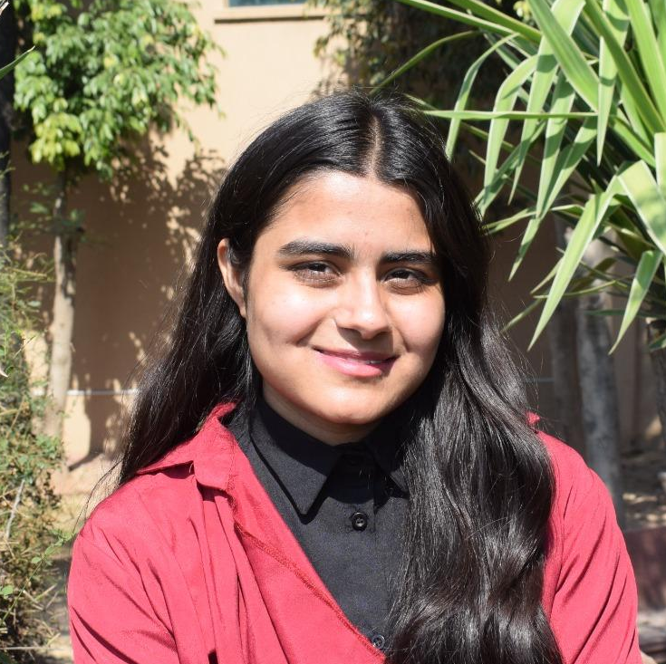
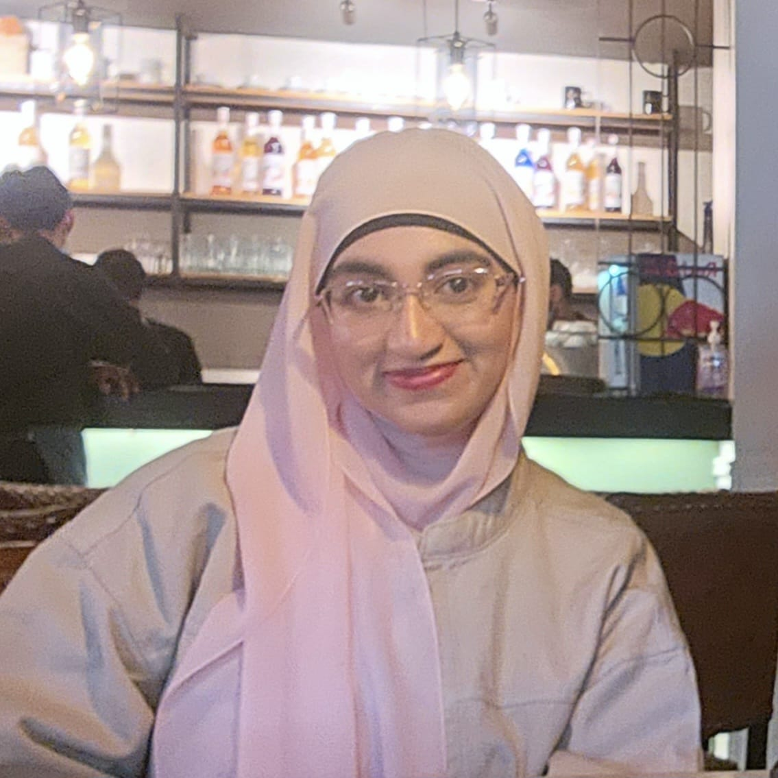
TEAM MEMBERS
Hadia Ali
Aimen Munawar
Maheen Akhtar Khan
410865
BESE-13-A
415867
BESE-13-A
429419
BESE-13-A

Slide 3
TABLE OF CONTENTS
01
INTRODUCTION
02
EXISTING SYSTEMS
03
OUR SYSTEM
04
SYSTEM ARCHITECTURE
05
MILESTONES
06
CONCLUSION

Slide 4
Problem Statement
Rising Cyber Threats with Low Awareness
Inadequate Existing Solutions
Need for a Localized Solution
[1],[2]

Slide 5
Target Audience
Educational
Institutions
General Public /
Individual Learners

Slide 6
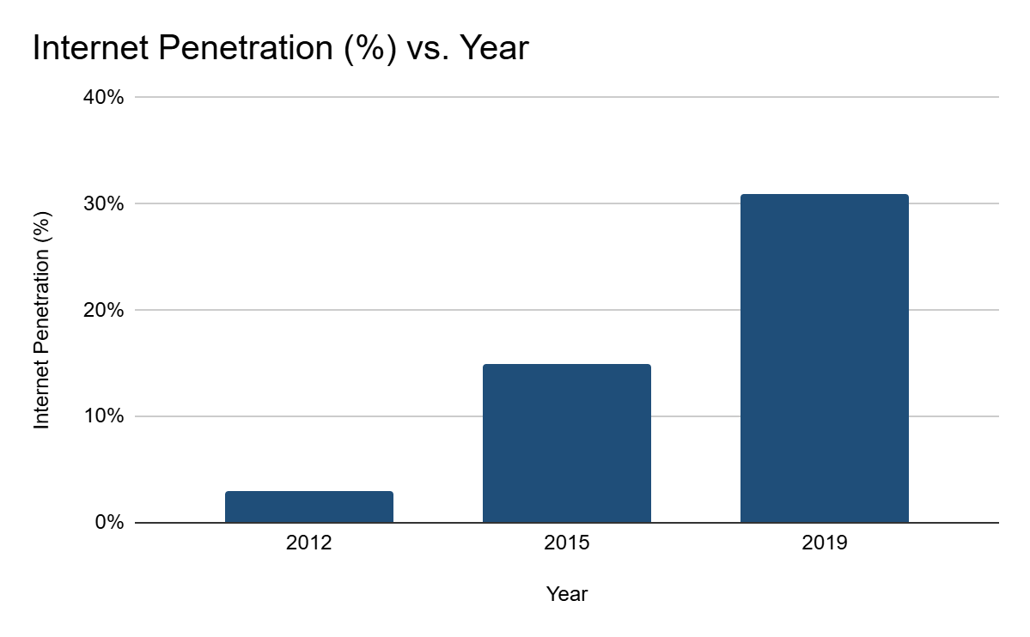
Literature Review
Internet Penetration
[4]

Slide 7
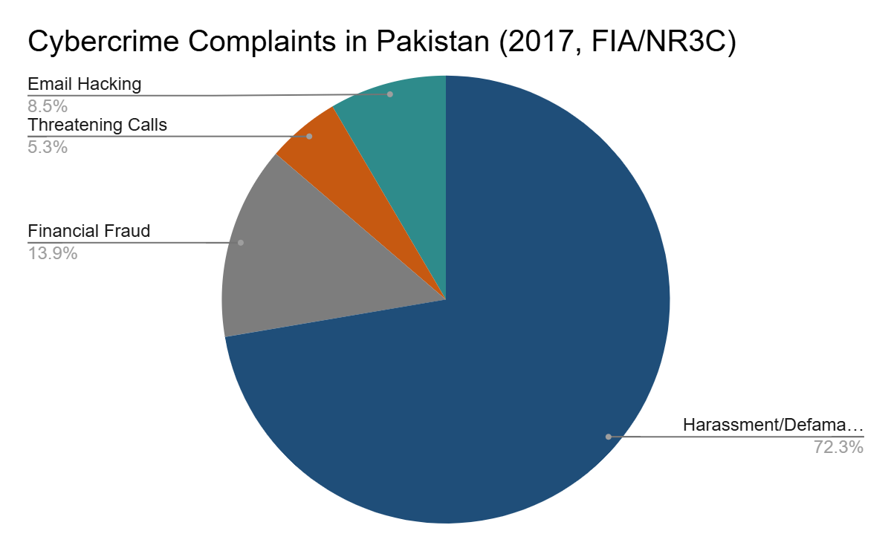
Literature Review
Cybercrime Complaints
[4]

Slide 8
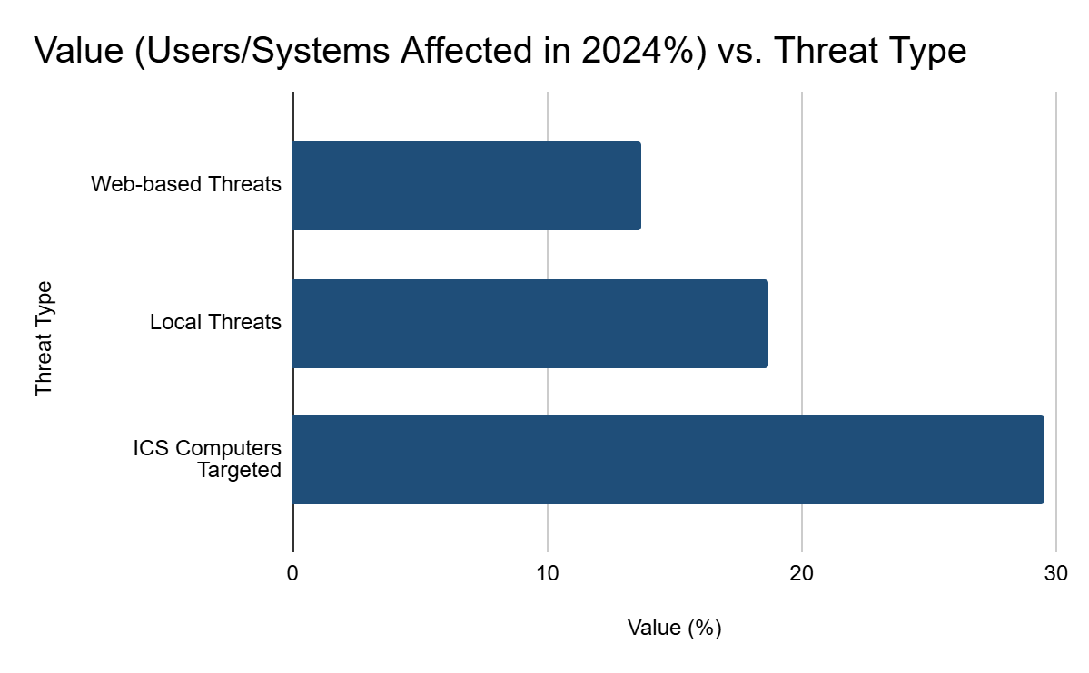
Literature Review
Threat Impact
[5]

Slide 9




EXISTING SOLUTIONS
CaniPhish | TryHackMe | GoPhish | Guardey
No Whatsapp phishing simulations Limited multilingual support (no Urdu) | No phishing simulation campaigns No Risk Analytics | No training/LMS features No Risk Analytics | No Pakistani context Limited personalization based on performance
[6]
[7]
[8]
[9]

Slide 10


GAPS IN EXISTING SOLUTIONS
Language & Localization Issues
Limited Attack Vector Coverage
Limited Assessment
Enterprise-Centric Design
Rigid Administration
No AI Integration

Slide 11
OUR SYSTEM
AUTHENTICATION & ONBOARDING
MULTILINGUAL COURSES
Secure logins, session management, and role-based onboarding.
01
03
Courses in English & Urdu with quizzes, videos, and certificates.
ROLE-BASED ACCESS
02
04
REPORTING
System/Admins upload content, users access assigned courses, quizzes, and videos
Admins get detailed user reports, learners track their own progress.

Slide 12
Our System:
PHISHING SIMULATION
05
REAL-TIME ANALYSIS
06
UNIFIED RISK SCORE
07
GAMIFICATION
08
Email, Whatsapp, and voice phishing campaigns with AI-generated texts and landing pages.
Track clicks, phishing responses, and call transcripts with AI sentiment analysis.
Combines phishing results and LMS progress to assign risk levels.
Points, badges, and leaderboards to keep users motivated.

Slide 13
OUR SYSTEM
INCIDENT REPORTING
COMMUNICATION & SUPPORT
09
10
Users report suspicious emails/Whatsapp; system validates and updates risk scores.
System notifications and 24/7 AI chatbot assistance.

Slide 14
Alignment with UN Sustainable Development Goals (SDGs)
SDG 9: Industry, Innovation, and Infrastructure
SDG 4: Quality Education

Slide 15


















TOOLS

Slide 16
System Architecture
Presentation
Layer
Application
Layer
Integrations
Data
Layer
NextJS, TypeScript for UI, Google Translate API for multilingual content
Clerk Authentication, NodeJS, ExpressJS for APIs
Gemini API, ElevenLabs API voice AI, Twilio for WhatsApp, Diagflow Agent, Nodemailer for emails
MongoDB Atlas as primary DB, Cloudinary for media storage

Slide 17
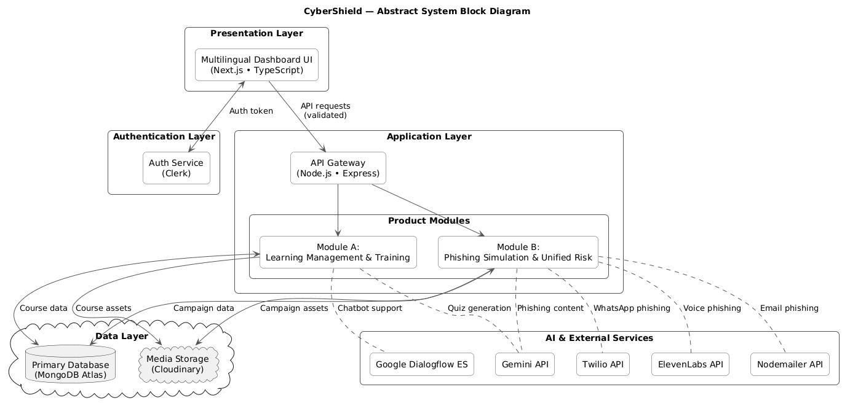
Abstract System Block Diagram

Slide 18
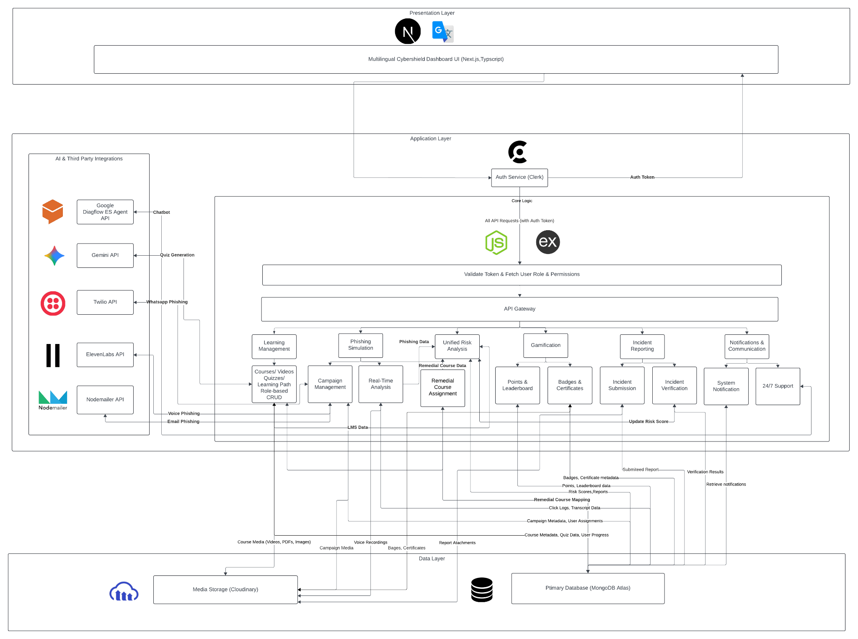
Detailed System Block Diagram

Slide 19
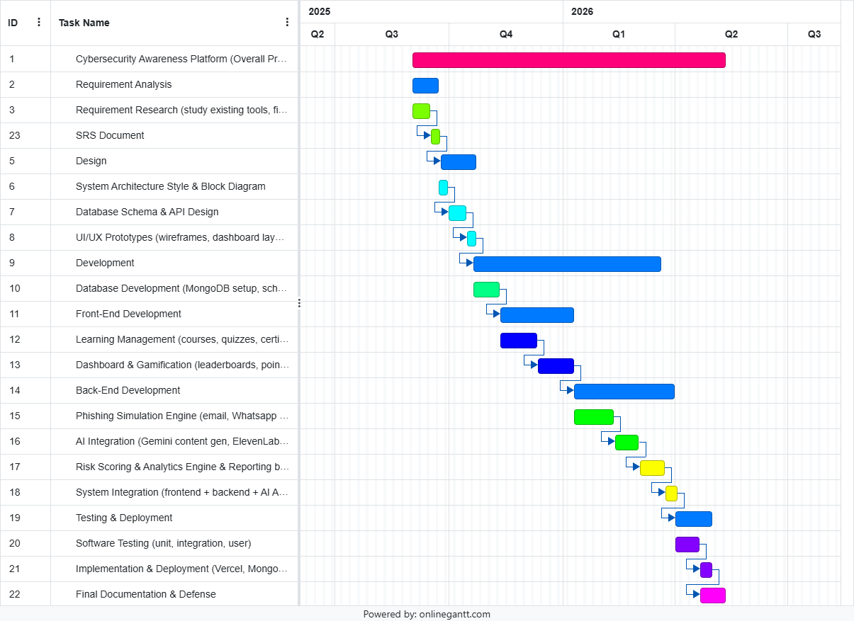
Project Milestones

Slide 20
Conclusion
CyberShield aims to strengthen cybersecurity awareness by combining engaging training with realistic phishing simulations. The platform empowers students, educators, and the general public to learn, practice, and build resilience against online threats.

Slide 21
REFERENCES
[1] R. Report, “18pc increase in phishing attempts noted during 2024,” Brecorder, Feb. 27, 2025. [Online]. Available: https://www.brecorder.com/news/40350307/18pc-increase-in-phishing-attempts-noted-during-2024
[2] K. Ahmed, “Study shows 91% Pakistani consumers to be at risk of responding to online scammers,” Arab News, Sep. 12, 2023. [Online]. Available: https://www.arabnews.com/node/2372011/pakistan
[3] S. Kausar and A. R. Laghari, “Social engineering attacks in Pakistan: Analyzing the weakest link in cyber security,” ojs.jdss.org.pk , Feb. 2025, doi: 10.47205/jdss.2025(6-I)32.
[4] M. R. Shad, “Cyber Threat Landscape and Readiness Challenge of Pakistan,” *Strategic Studies*, vol. 39, no. 1, pp. 1–19, 2019. [Online]. Available: https://www.issi.org.pk/wp-content/uploads/2019/04/1-SS_Muhammad_Riaz_Shad_No-1_2019.pdf

Slide 22
REFERENCES
[5]J. Rizvi, “Cyber threats in Pakistan’s finance sector surge by 114pc in 2024: report,” The News International, Nov. 18, 2024. [Online]. Available: https://www.thenews.com.pk/print/1252393-cyber-threats-in-pakistan-s-finance-sector-surge-by-114pc-in-2024-report
[6] CanIPhish, “Simulate phishing threats & train your employees | CanIPhIsh,” CanIPhish. https://caniphish.com/
[7] “TryHackMe | Cyber Security Training,” TryHackMe. https://tryhackme.com/
[8] J. Wright, “GoPhish - Open Source Phishing Framework.” https://getgophish.com/
[9]Guardey, “Guardey | Security Awareness Training,” Guardey, May 27, 2025. https://www.guardey.com/

Slide 23
THANK YOU

Slide 24


